Slide 1
FooCommerce
By: Hunter Giordullo

Slide 2
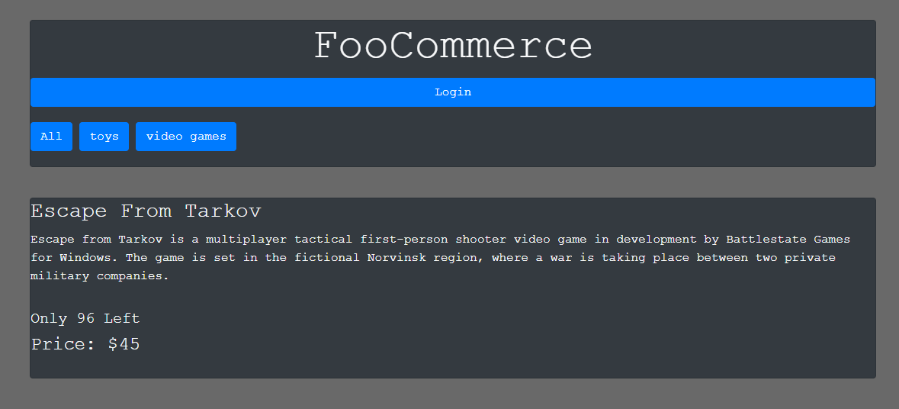
FooCommerce
FooCommerce is a basic ecommerce site selling all types of goods, but the two used for testing were toys and video games.

Slide 3
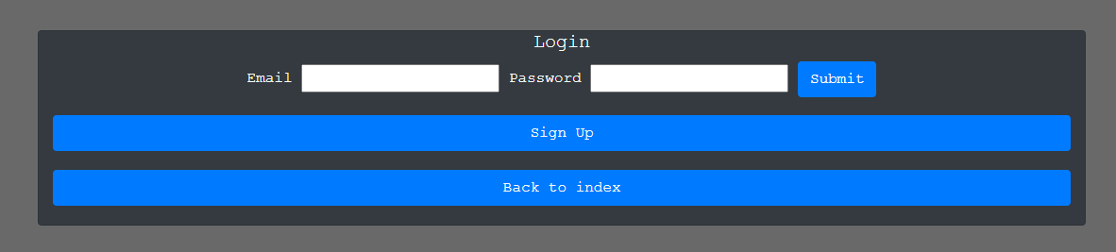
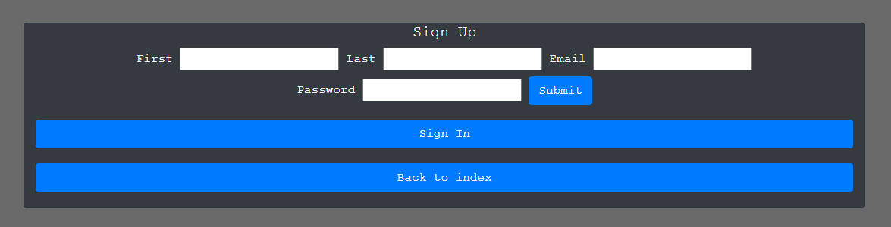
Authentication
There is a basic sign in screen and backend authentication to only allow admins and users to do specific things. The users can place orders and the admins can edit those orders and the products available.

Slide 4
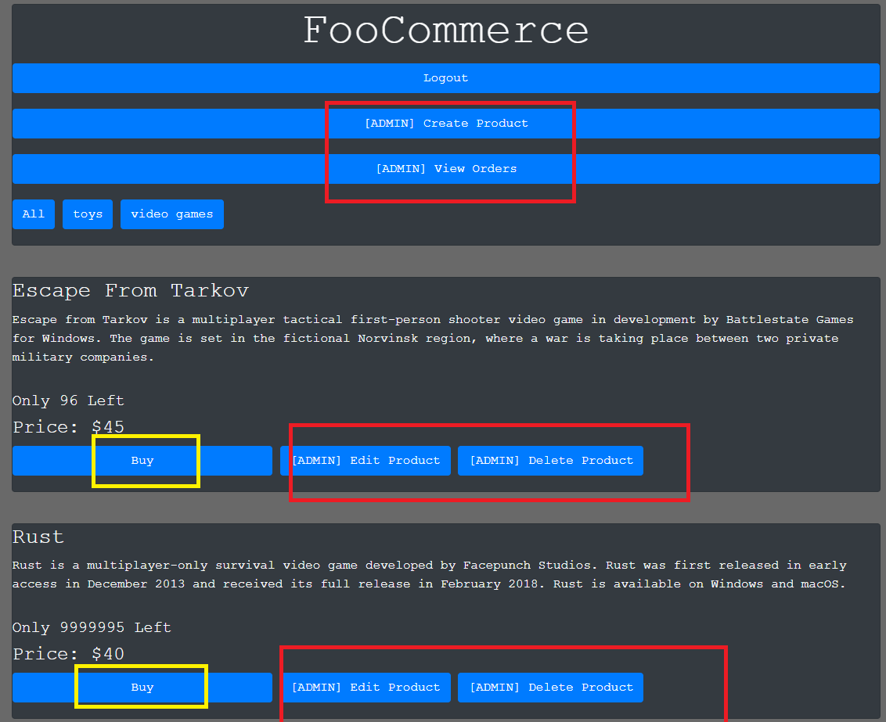
Admin/User only features
The admin only features are highlighted in red while the user only features are in yellow to display what is hidden from visitors.

Slide 5
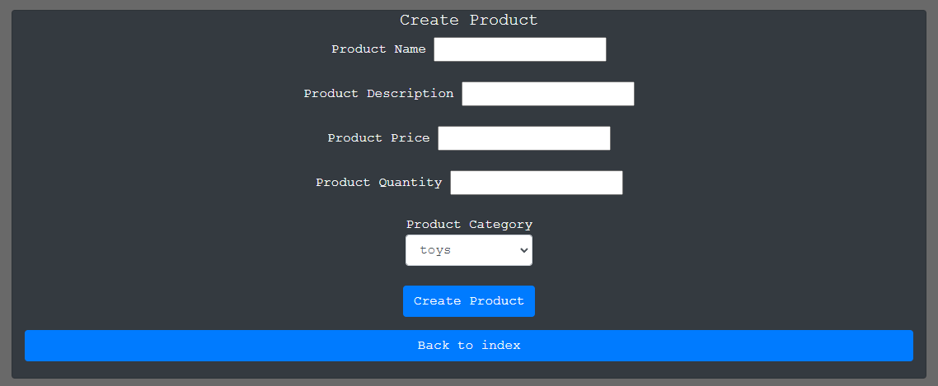
Create a Product
Here you can create a product as an admin by inputting in the product name, description, price, and quantity that is for sale. You can also categorize it!

Slide 6
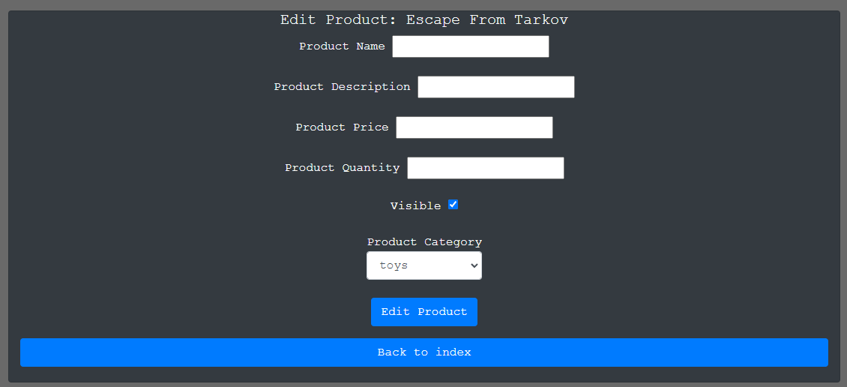
Edit Product
Here you can edit a product as an admin by inputting in the fields you want edited such as the product name, description, price, visibility, and quantity.

Slide 7
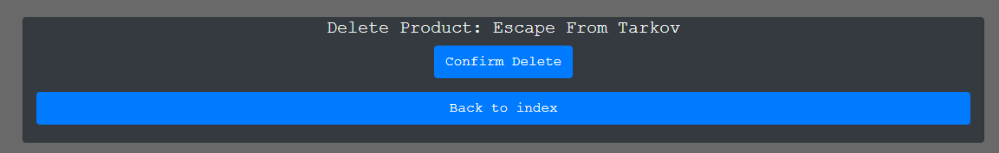
Delete a Product
Here is the page in which admins can delete a product from the database. It will ask for a confirmation before deleting it.

Slide 8
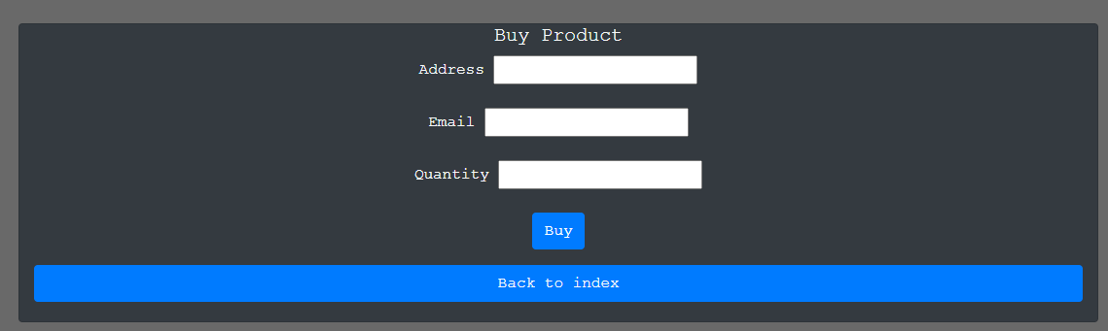
Buy a Product
On this page a customer can buy a product by typing in their address, email, and the amount they want to purchase.

Slide 9
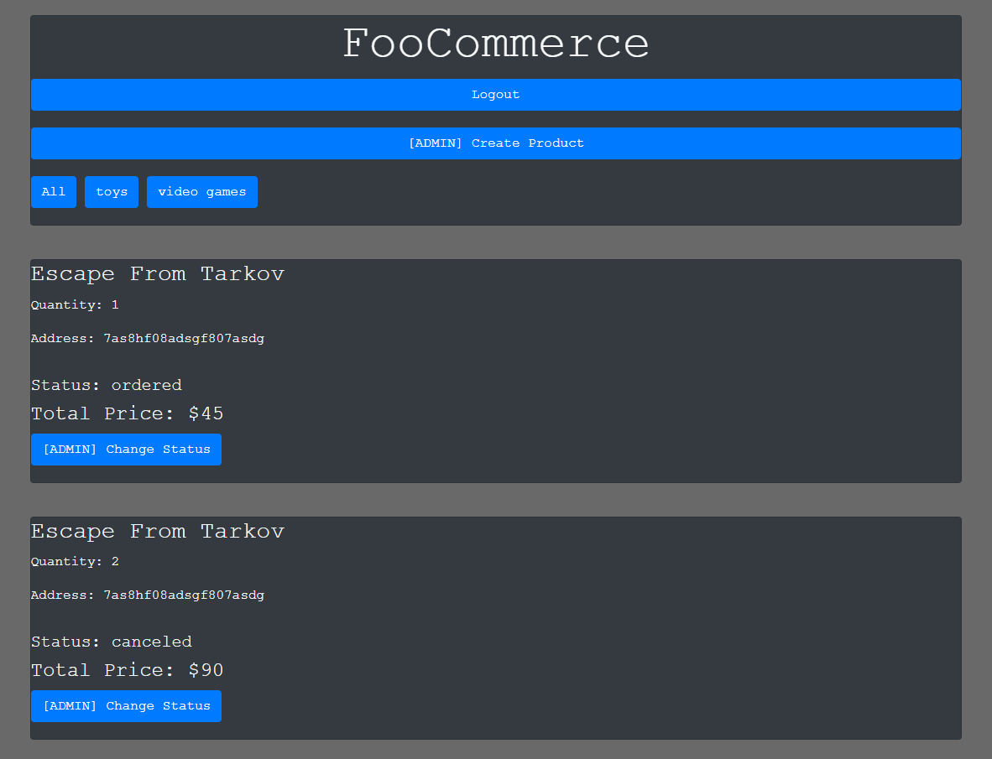
View Orders
Admins can view orders and modify their status. The total paid, order status, address, and quantity can be viewed here as well.

Slide 10

Changing the Order Status
Here is the change status page for admins they can select the status then submit it to the database to be changed.

